Slide 1







Social science
Prepared by
Mallikarjun S
Asst Teacher
Mallikarjun S M
M S Mallikarjun
smallikarjun798@gmail.com
87470 98574

Slide 2

GEOGRAPHY
Chapter – 2
INDIAN PHYSIOGRAPHY

Slide 3
In this unit you learn
Physiographic Divisions of India
1. The Northern Mountains
2. The Northern Great Plains
3. The Peninsular Plateau
4. The Costal Plains and Islands
Features and Importance of the physiographic divisions

Slide 4
General features of the landforms of India
India is a vast country and it has a variety of landforms. They include mountains, plateaus, plains, valleys and coastal plains.
These have influence on the rivers system, climate, natural vegetation, land use, agriculture, transport, distribution of population etc.

Slide 5
PHYSIOGRAPHIC DIVISIONS OF India
On the basis of physiography, India can be divided into four major divisions.
1. The Northern Mountains
2. The Northern Great Plains
3. The Peninsular Plateau
4. The Coastal Plains And Islands

Slide 6
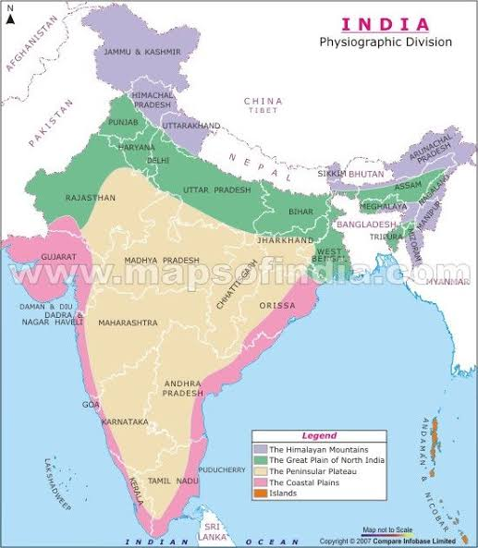
The Northern
Mountains
The Northern
Grate Plains
Deccan Plateau
The East Coast and
West Coast
Indian Islands

Slide 7
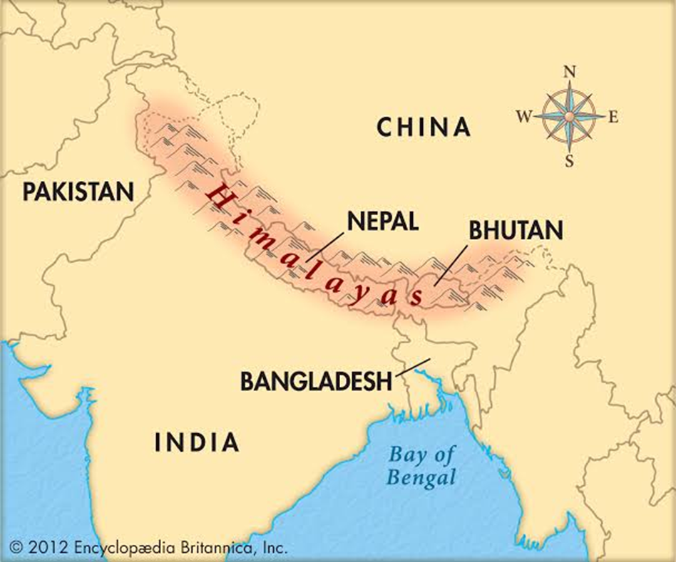
1. The northern mountains
The northern mountains
comprise of the
Himalayas which are
a group of young fold
mountains
They are the highest
mountain ranges in
the world
They have highest peaks,
deep valleys and gorges, glaciers, passes etc.

Slide 8
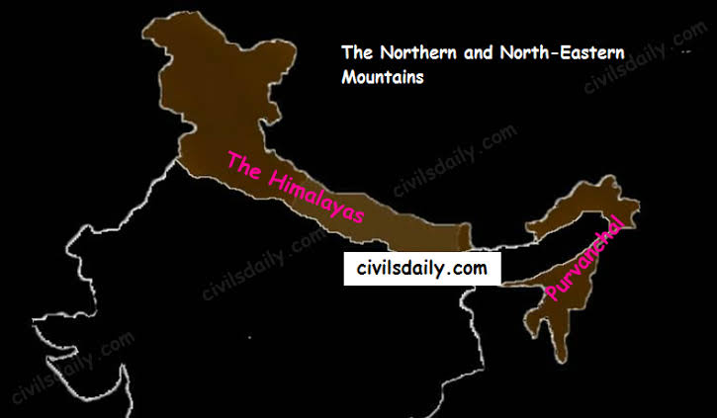
In India they extends from the Indus Gorge in west to the Brahmaputra Gorge in the east for 2400 kms
The width various from
240 to 320 kms

Slide 9
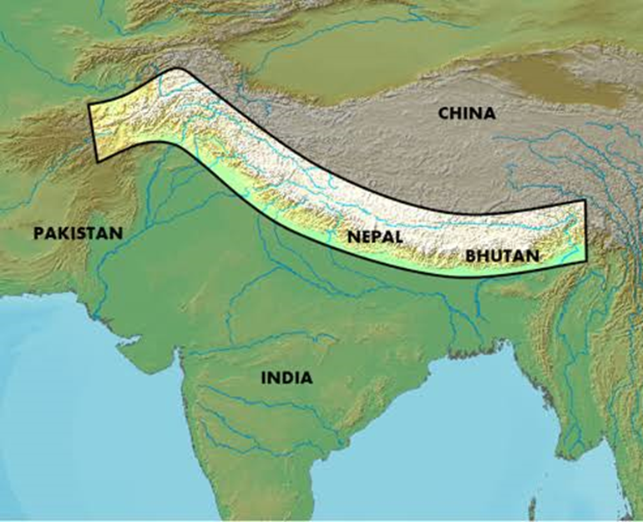
They are broader in the west and narrow in the east
They covered an area
of about 5 lakh km².
Generally they have
steep slopes towards
India (south) and
gentle towards Nepal
(North)

Slide 10
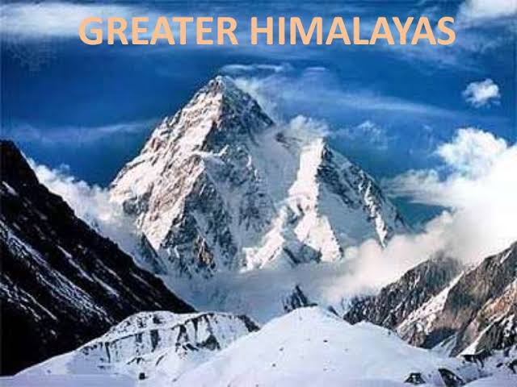
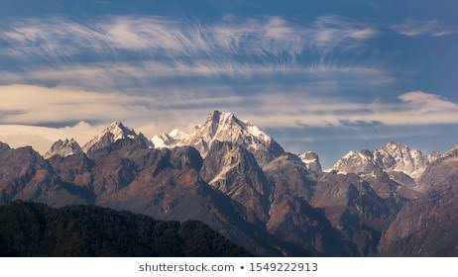
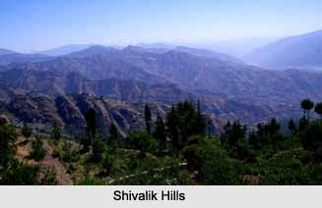
Three parallel ranges of the Himalayas
Greater
Himalayas
Lesser
Himalayas
Siwalik
Hills

Slide 11
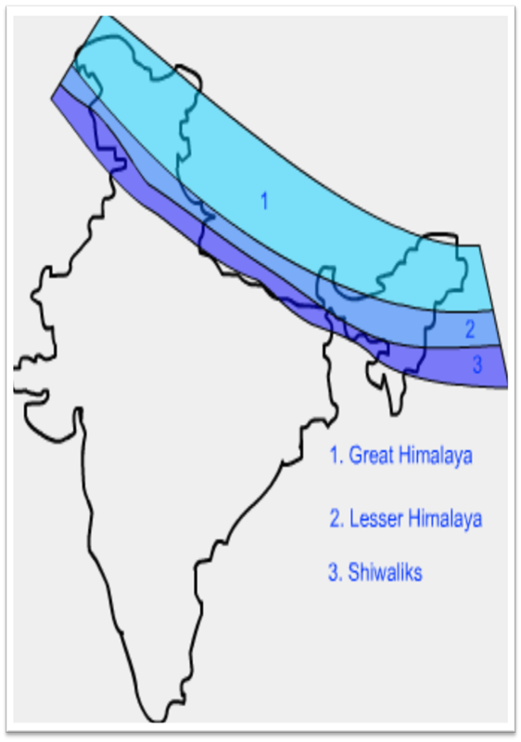
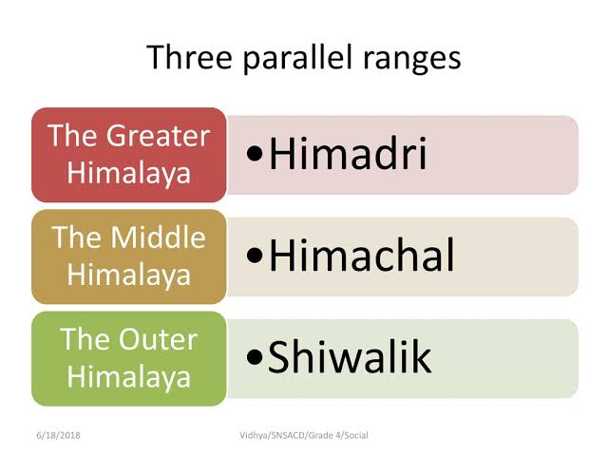

Slide 12
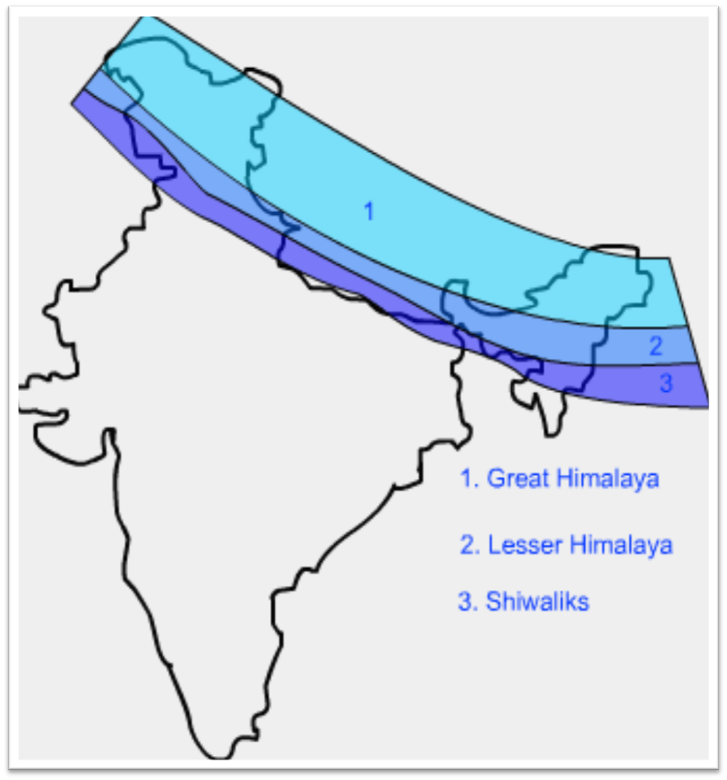
(A). The greater Himalayas
They are the inner most,
continuous and highest
ranges
The average height of
the range is 6100 mts
These ranges have
many high peaks.
Among them Mt. Everest
(8848 mts) is the highest

Slide 13
The other peaks are – Kanchanajunga (8559 mtrs), Makulu (8481 mts), Dhaulagiri (8172mts), Manaslu (8156mts), Nandadevi etc
As the Greater Himalayas are covered with snow throughout the year, these ranges are called ‘ Himadri ’
They are the home of many glaciers, such as Gangotri and Yamunotri glaciers

Slide 14
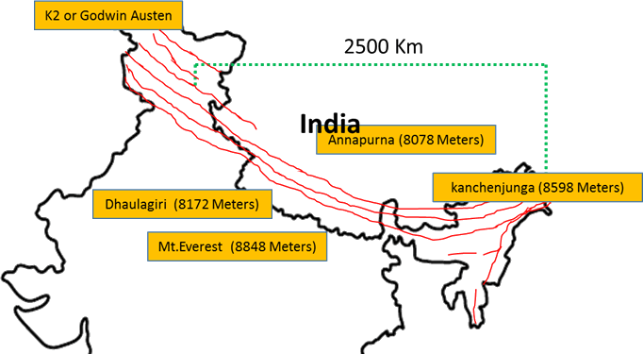
the mountains lying to the north west of the Himadri are called ‘ Trans Himalayas ’
They comprises of Karakoram range, where the highest peak K₂ or Mt. Godwin Austin is located and it is the highest peak in India

Slide 15
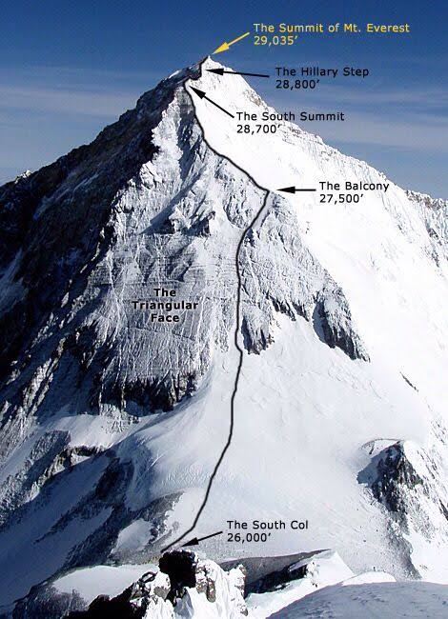
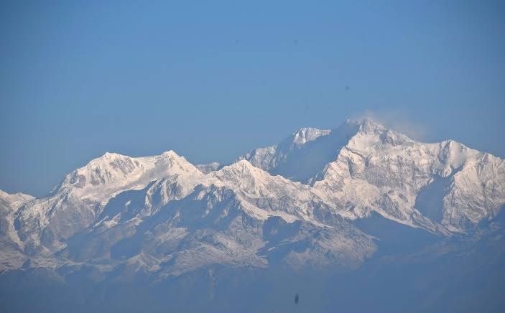
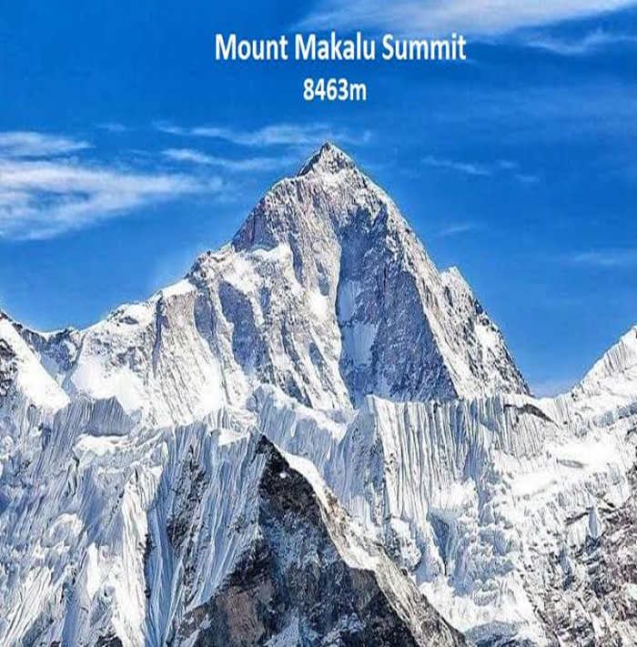
Mt. Everest
Kanchanajunga

Slide 16

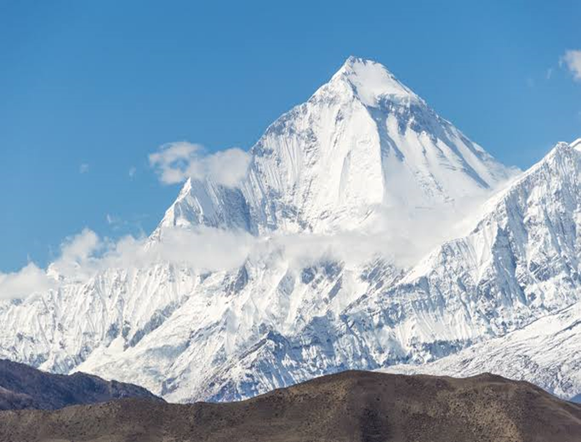
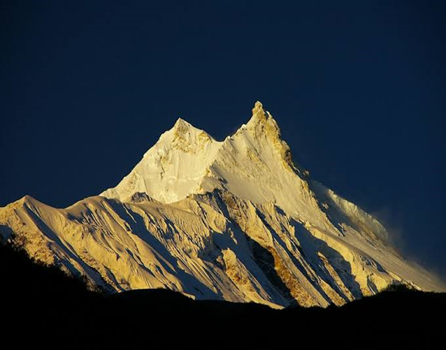
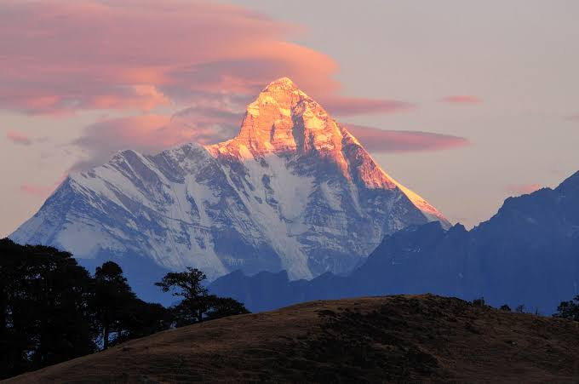
Manaslu
Nandadevi

Slide 17
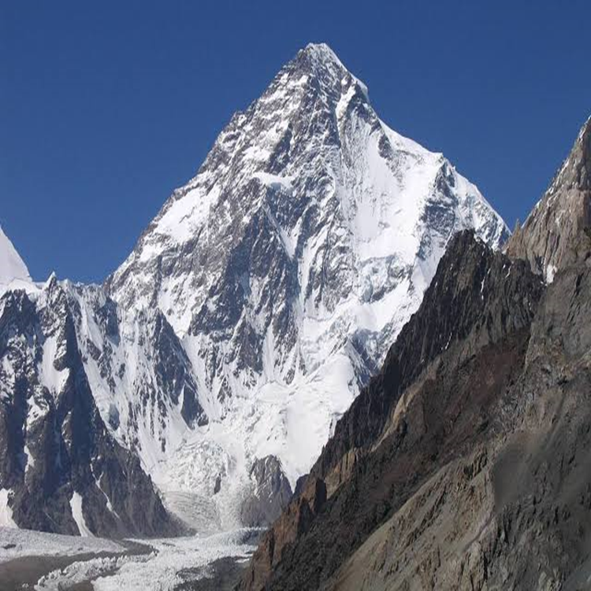
K2 or Mt. Godwin Austin

Slide 18
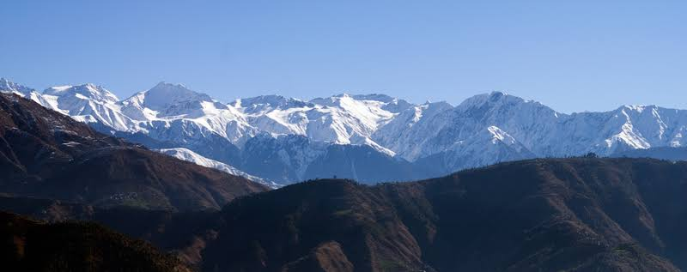
(B). The lesser Himalayas
These ranges have located to the south of the Greater Himalayas
They are also known as ‘ Himachal ’
They are 60 to 80 km wide and 1500 to 4500 mts high

Slide 19
There are many parallel ranges in the lesser Himalayas. They contain many valleys such as Kashmir valley, Kangra valley, Kulu valley etc
These are also noted for hill stations such as – Shimla, Ranikhet, Mussorie, Nainital and Darjeeling

Slide 20
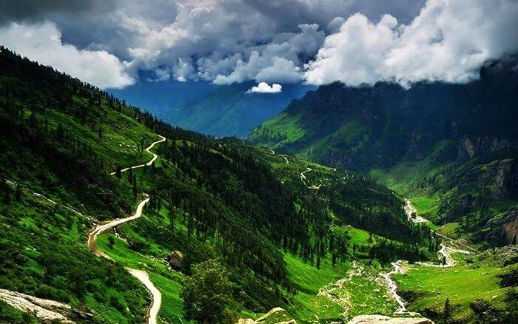
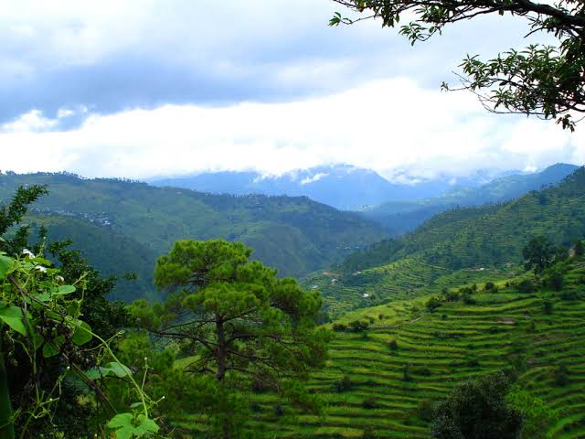
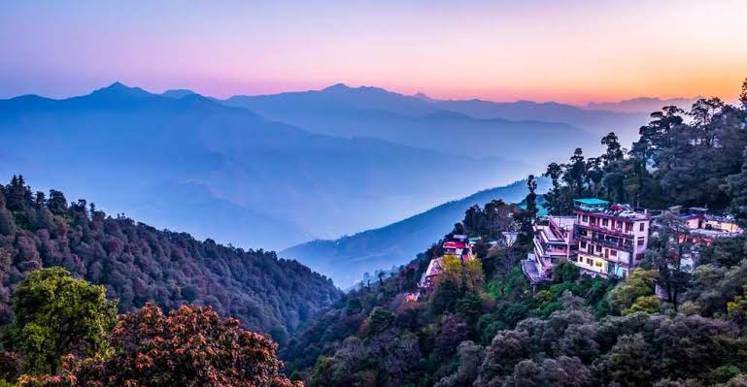
Beautiful Hill Stations of the Lesser Himalayas

Slide 21
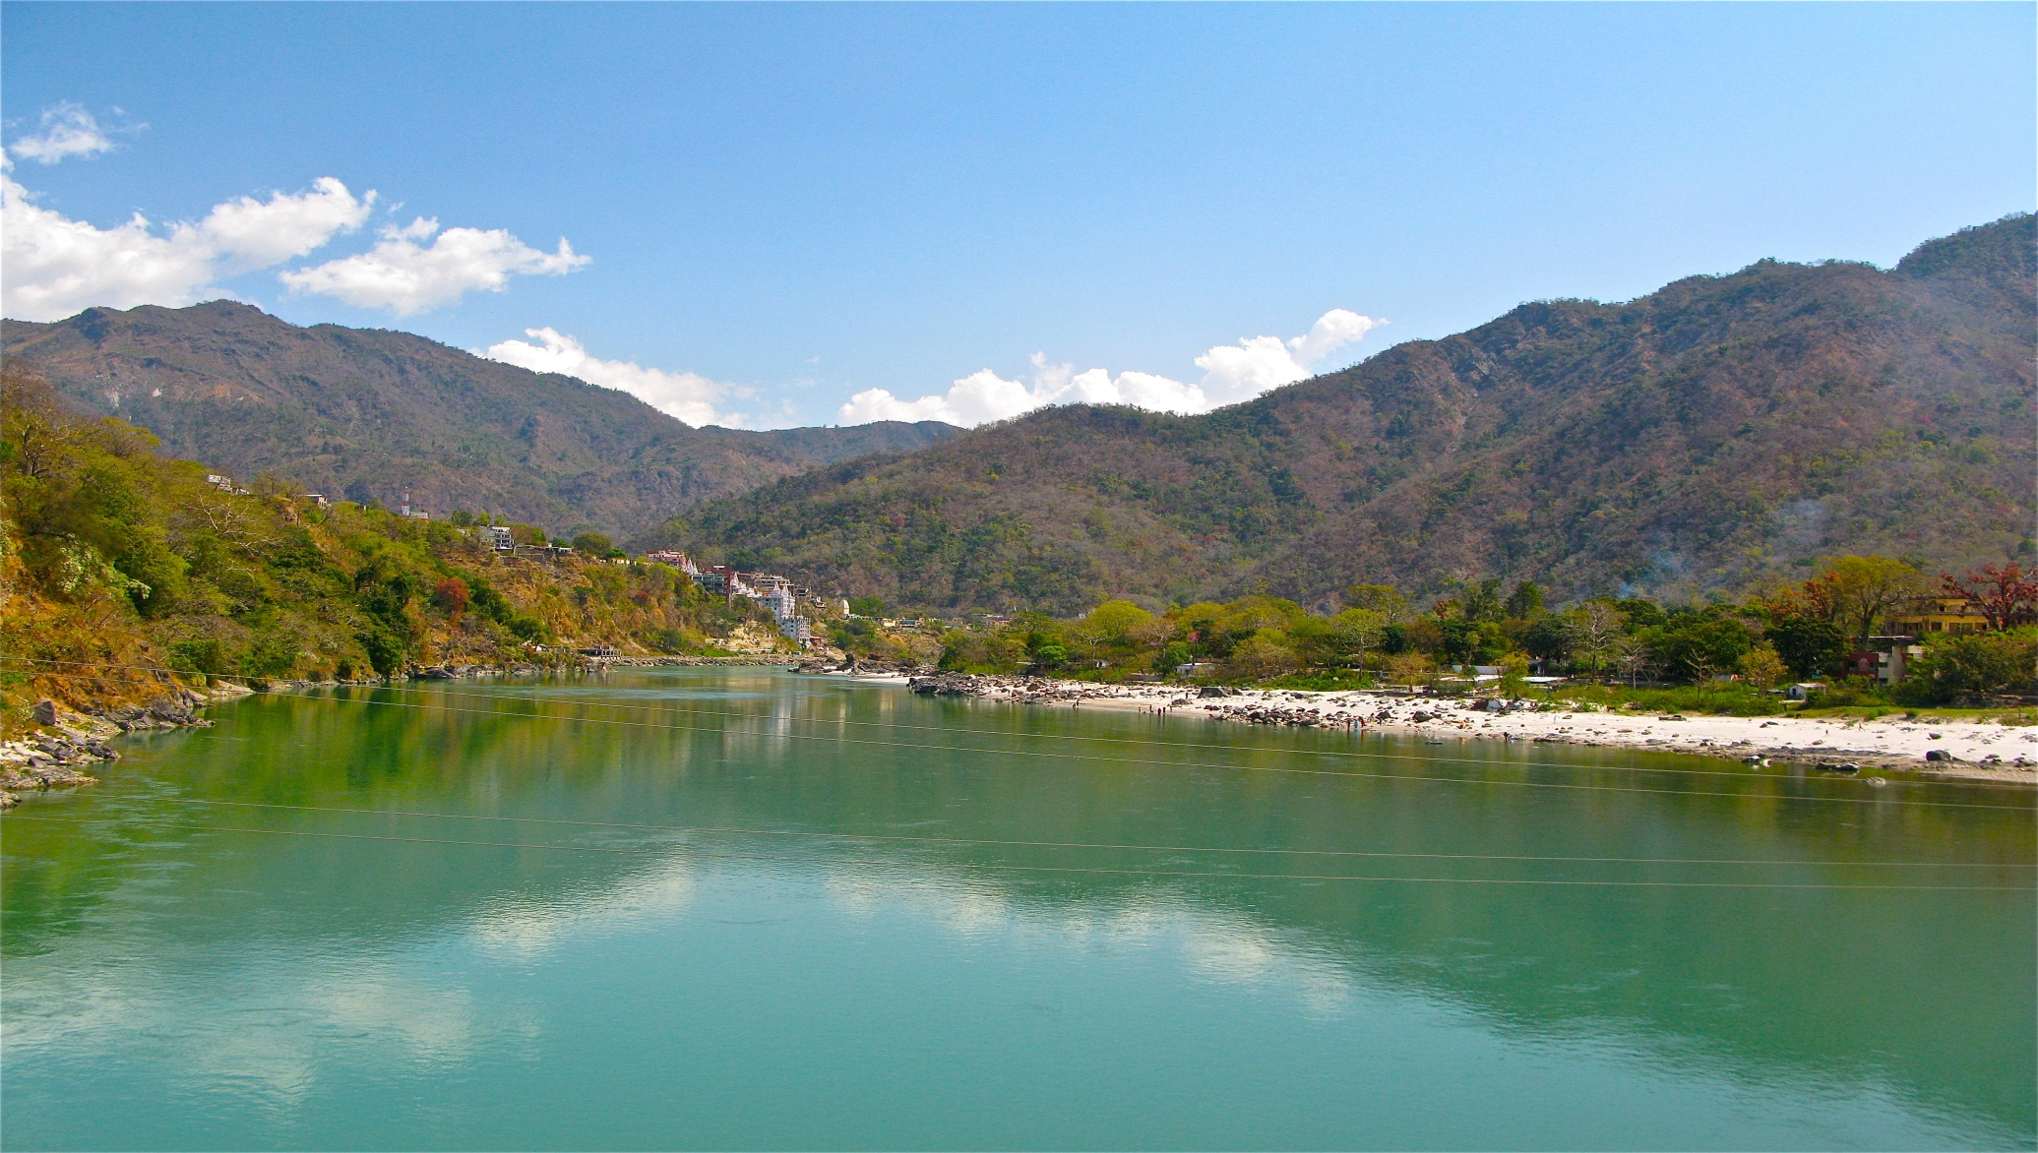
(C). The Siwalik hills

Slide 22
The Siwalik hills are the outer most ranges or foothills of the Himalayas, they located to the South of the main Himalayas.
These are also known as ‘ Outer Himalayas ’
These are the lowest range of the Himalayas, with a height of 600 to 1500 mts and width is varying from 15-150 km.

Slide 23
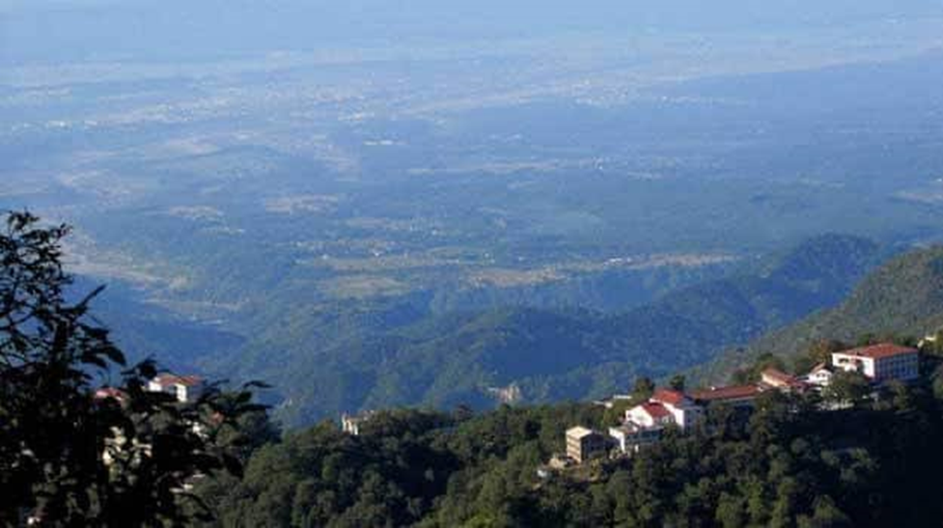
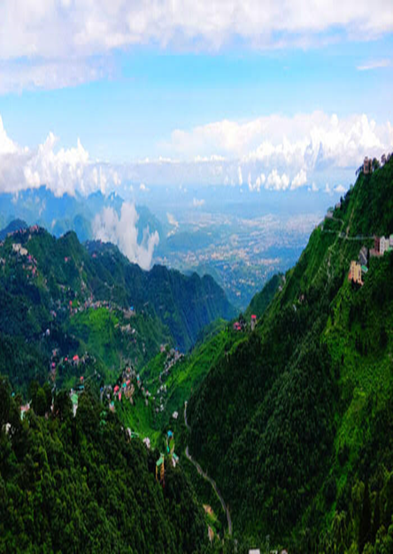
They extend from Jammu-Kashmir in the west to Arunachal Pradesh in the east.
They have flat-bottom structured valleys, which are known as ‘ Doons ’
eg; Dehradoon.

Slide 24
Importance of Himalayas
The Himalayas act as natural frontiers and
prevent foreign invasions
They prevent cold winds from central Asia
They obstruct the rain bearing clouds and causes heavy rainfall

Slide 25
4. Their slopes have thick forests and ideal
for plantation crops
5. They are the store house of minerals
6. The Himalayas are the birthplace of
many rivers and waterfalls which are
used to generate hydro-electric power.

Slide 26
2. Northern great plains
It lies between the Himalayas and the Peninsular plateau
It is formed by the depositional work of three river systems namely – Sutlej, Ganga and Brahmaputra
It is the largest alluvial soil tract in the world, extending east to west – a length of 2500 kms

Slide 27
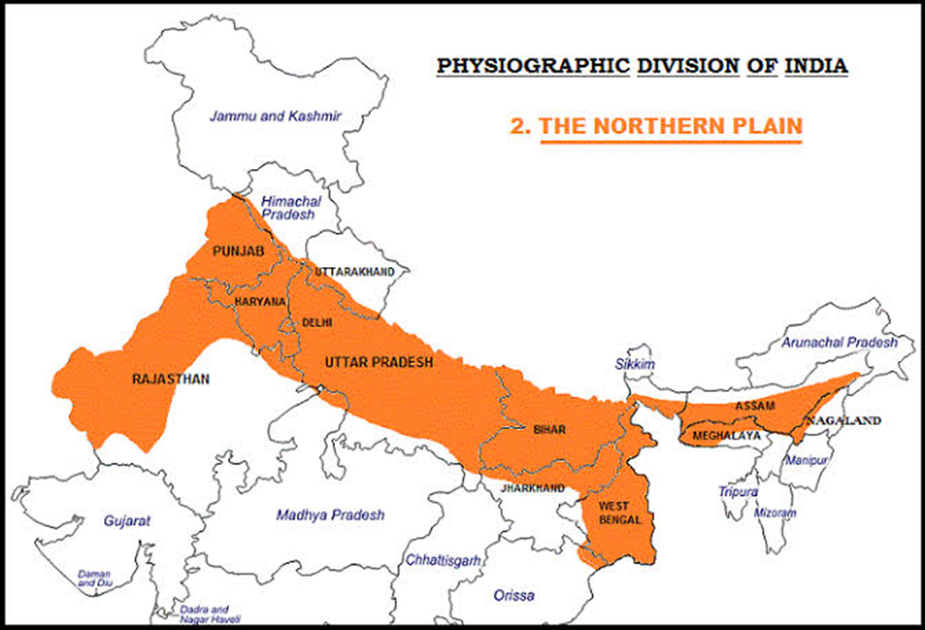
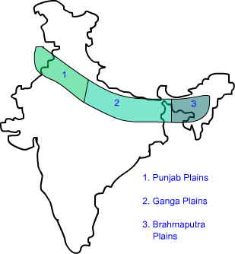
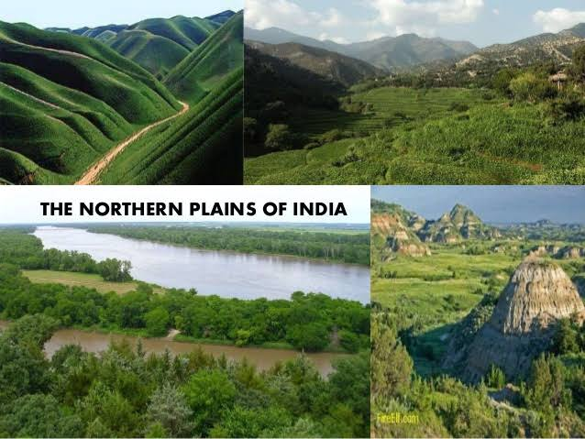

Slide 28
IMPORTANCE OF THE GREAT PLAINS
Very suitable for irrigation and agriculture
Its level land supports a network of roads, railways and means of communications.
They are useful for industrialization, urbanization and trade.
A number of pilgrim centers are located here.

Slide 29
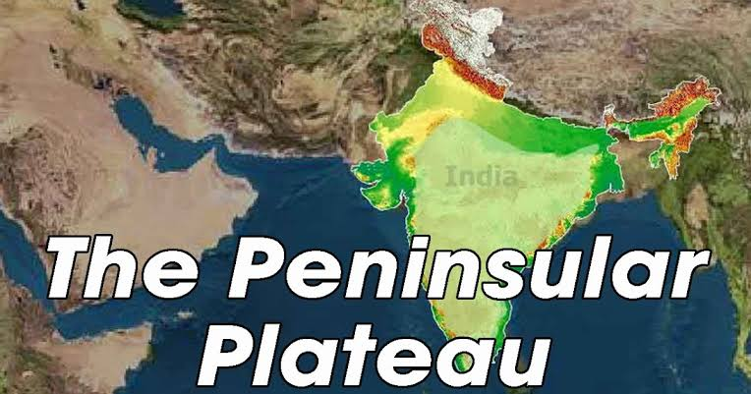
3. THE PENINSULAR PLATEAU

Slide 30
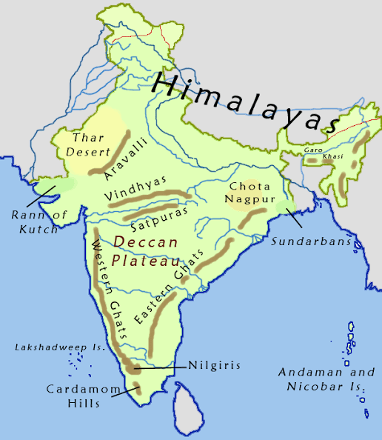
This is the largest physical divisions of India.
It lies to the South of
the Great Plains
and occupies about
16 Lakh sq.km.
It is roughly triangular
in shape and its apex
is formed by
cape of Kanyakumari.

Slide 31
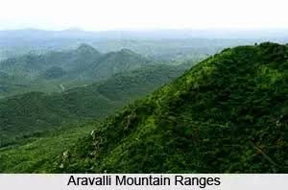
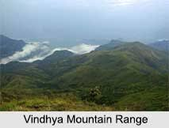
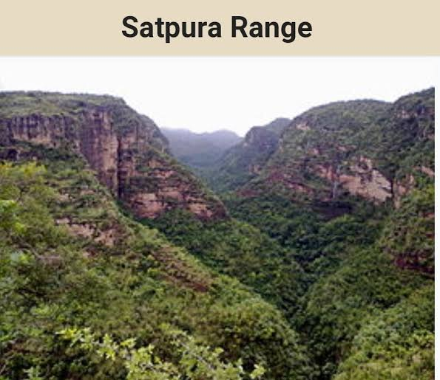
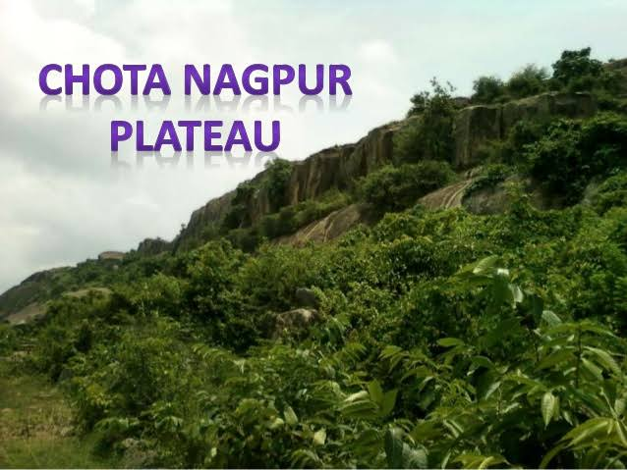
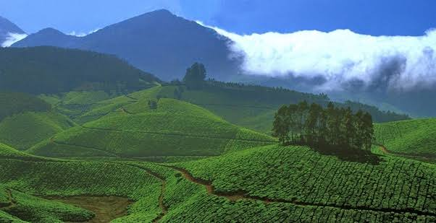

It is bounded by many hills and plateaus namely – the Aravalli, Vindhya and Satpuras, Western Ghats, Eastern Ghats, Chotanagpur ranges, Deccan plateau, Malwa plateau etc.
Deccan plateau

Slide 32
Differences between the western ghats and eastern ghats
Western Ghats
Eastern Ghats
These are continuous ranges
Run parallel to the West Coast of India
Extended from Tapi Valley to Kanyakumari
Anamudi (2695 m) is the highest peak
These are not continuous ranges
Run parallel to the East Cost of India
Extended from the Mahanadi Valley to Nilgiri hills
Armakonda (1680 m) is the highest peak

Slide 33
Importance of the peninsular plateau
Rich in minerals , thick forests and bio- diversity
It has influence on South-west monsoons
Useful for agriculture
Birth place of many South Indian rivers
Useful for the generation of hydro-electricity
Well known for beautiful hill stations

Slide 34
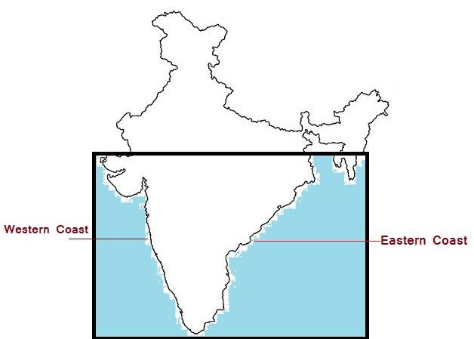
The coastal plains
It extends from the Rann of Kutch in the West to the Delta of Ganga in the East.
The Coastal Plains
are divided into
two parts –
Western Coastal Plain
and
Eastern Coastal Plain

Slide 35
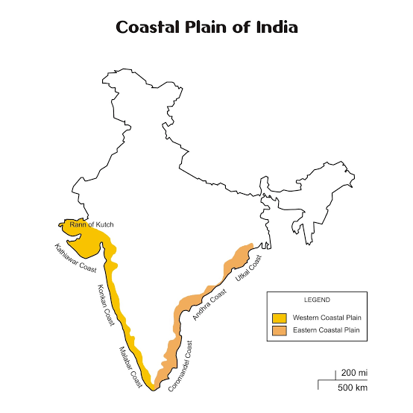

Slide 36
Differences between western and eastern coastal plains
Western Coast
Eastern Coast
It lies between the Western Ghats and the Arabian Sea
Extends from the Rann of Kutch to Kanyakumari
It is narrow, steep and rocky
Divided into three parts – Konkan Coast, Karnataka Coast and Malabar Coast
It lies between the Western Ghats and the Bay of Bengal
Extends from river Subarnrekha to Kanyakumari
Broader than the Western Coastal Plains
Dividede into two parts – the Northern Circar and Coromandal Coast

Slide 37
Importance Of Coastal Plains
Provide some natural harbours which help in carrying on foreign trade.
Useful for fishing and shipbuilding.
Useful for agriculture and production of salt.
Beaches along the Coasts attract tourists.
Backwater useful for navigation.

Slide 38
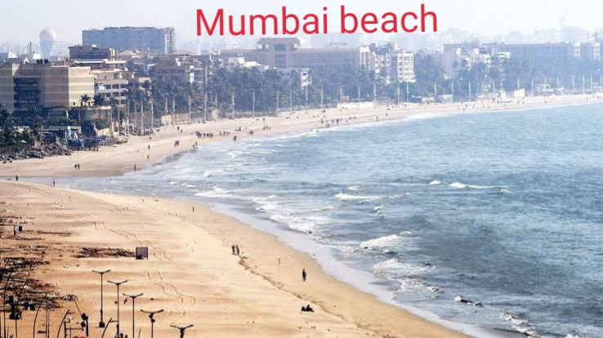
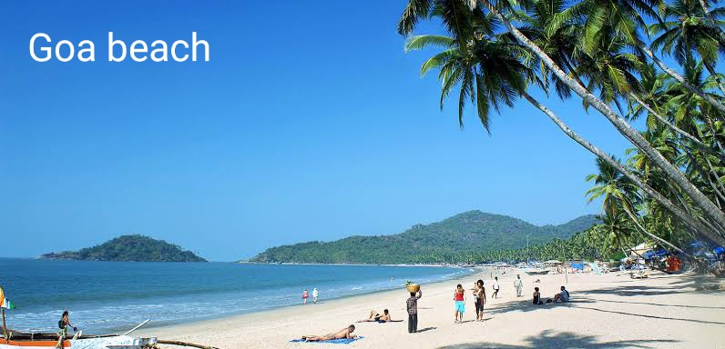
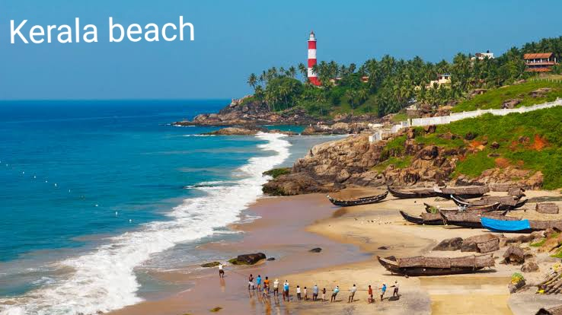
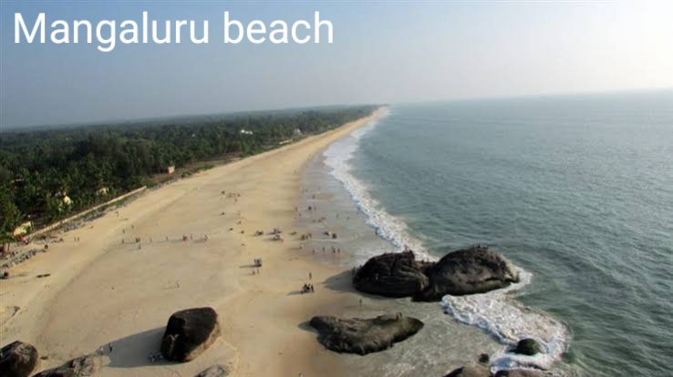

Slide 39
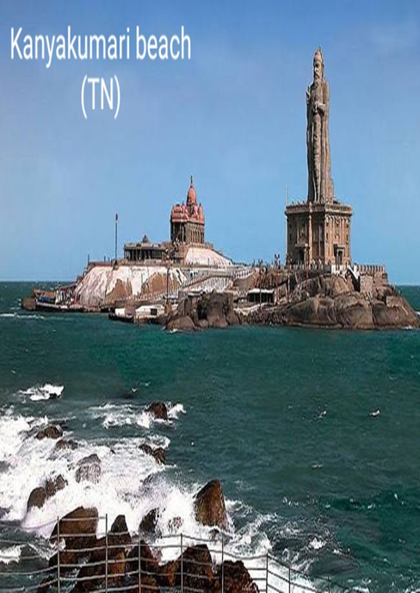
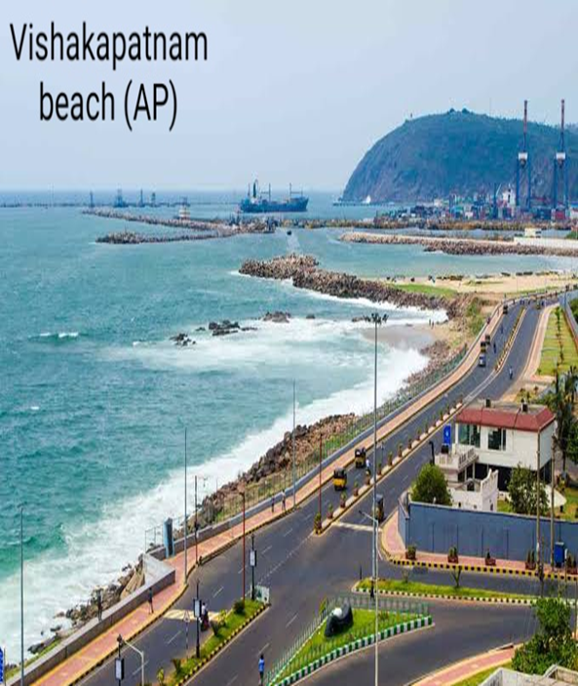
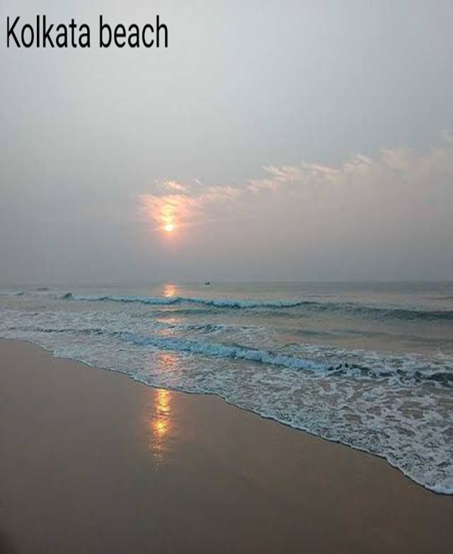

Slide 40
Islands of India
There are about 247 islands in India.
204 island are in the Bay of Bengal and 43 are in the Arabian Sea.
Andaman and Nicobar island are in the Bay of Bengal.
Lakshadweep islands are in the Arabian Sea.

Slide 41
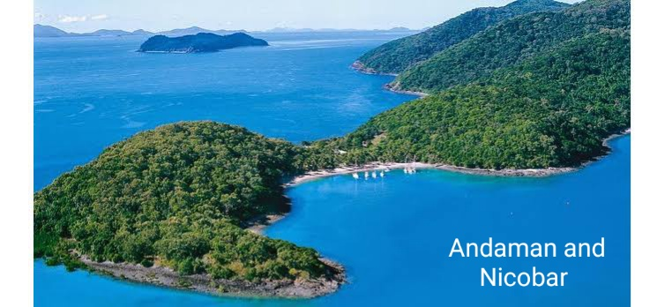
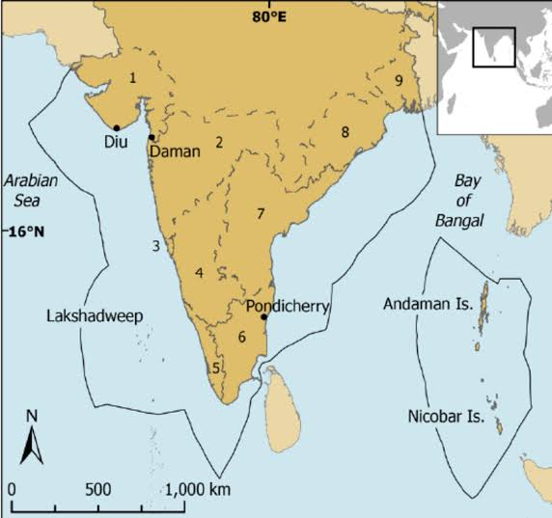
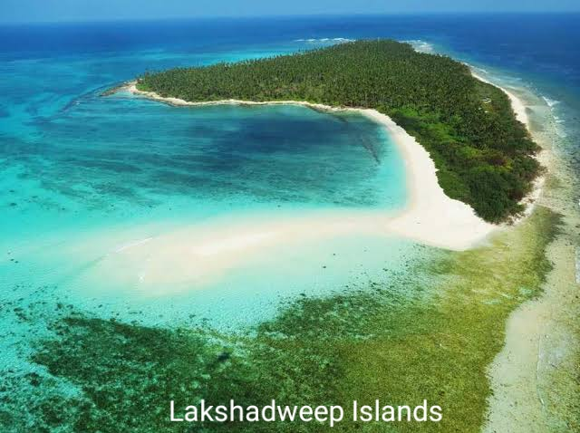

Slide 42

Thank You

