Slide 1
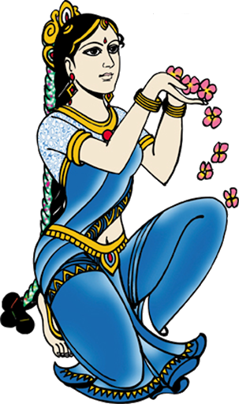

WEL COME TO
SOCIAL STUDIES
QUIZ. 2022 - 23
GRADE – IX

Slide 2


Mr. Mallikarjun.S
Asst. Teacher
JB High School, Bhagyanagar
contact.: 8747098574
Concept and Prepared by

Slide 3
RULES OF THE QUIZ
SOCIAL STUDIES QUIZ is a game of
10 questions and by playing the quiz students
can win Rs.20
Amount will increase from
question to question
Three HELPLINES -- Textbook,
Best Friend and Fifty-Fifty
Students can choose Helpline
by asking as Helpline if they need
Extra 30 Seconds time for Textbook,
Best Friend Helpline
Fifty-Fifty --- students will get only TWO answer
options among the four
30 Seconds time for each question to answer
The student / Group who answered for all
the questions will be declared as WINNERS
10) Rs.50
9) Rs.25
8) Rs.20
7) Rs.15
6) Rs.10
5) Rs.5
4) Rs.4
3) Rs.3
2) Rs.2
1) Rs.1
NEXT

Slide 4
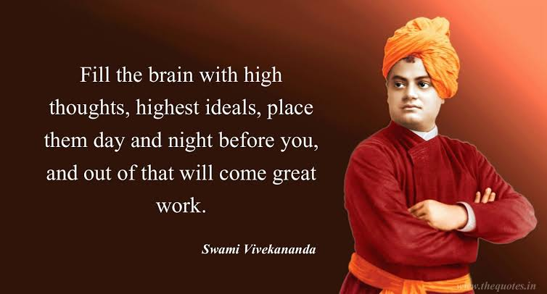
WEL COME TO
SOCIAL STUDIES
QUIZ
TEAM – BLUE

Slide 5
Q.1. The National Assembly framed a Constitution in 1791 to limit the power of the …..
A) Theocracy
B) Wealthy Man
C) Monarch
D) Businessmen
NEXT

Slide 6
Q.2. Who wrote an influential pamphlet ‘What is the Third Estate’ ?
A) Mirabeau
B) Jean-Paul Marat
C) Abbe Sieyes
D) Olympe de Gouges
NEXT

Slide 7
Q.3. A triangular slave trade took place between – Europe, the Americas and ……
A) Asia
B) France
C) Australia
D) Africa
NEXT

Slide 8
4. The Tropic of Cancer does not pass through,
A) Odisha
B) Rajasthan
C) Chattisgarh
D) Tripura
NEXT

Slide 9
Q.5. The easternmost longitude of India is,
A) 68° 7’ E
B) 77° 6’ E
C) 97° 25’ E
D) 82° 32’ E
NEXT

Slide 10
Q.6. How many States and Union Territories does India have ?
A) 28 States and 7 UTs
B) 28 States and 8 UTs
C) 29 States and 9 UTs
D) 26 States and 6 UTs
NEXT

Slide 11
Q.7. The word ‘Democracy’ comes from the Greek word,
A) Democracia
B) Demos
C) Demokratia
D) Kratia
NEXT

Slide 12
Q.8. The most common form that democracy takes in our time is that of,
A) Representative democracy
B) Limited democracy
C) Maximum democracy
D) None of the above
NEXT

Slide 13
Q.9. Consumption of chemical fertilizers is highest in which state of India ?
A) Haryana
B) Punjab
C) Rajasthan
D) Himachal Pradesh
NEXT

Slide 14
Q.10. Finance raised to operate a business is called ….
A) Labour
B) Capital
C) Enterprise
D) Land
NEXT

Slide 15

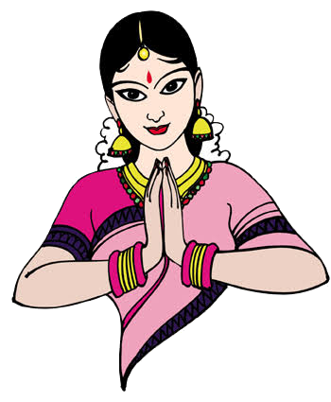
Thank You

Slide 16
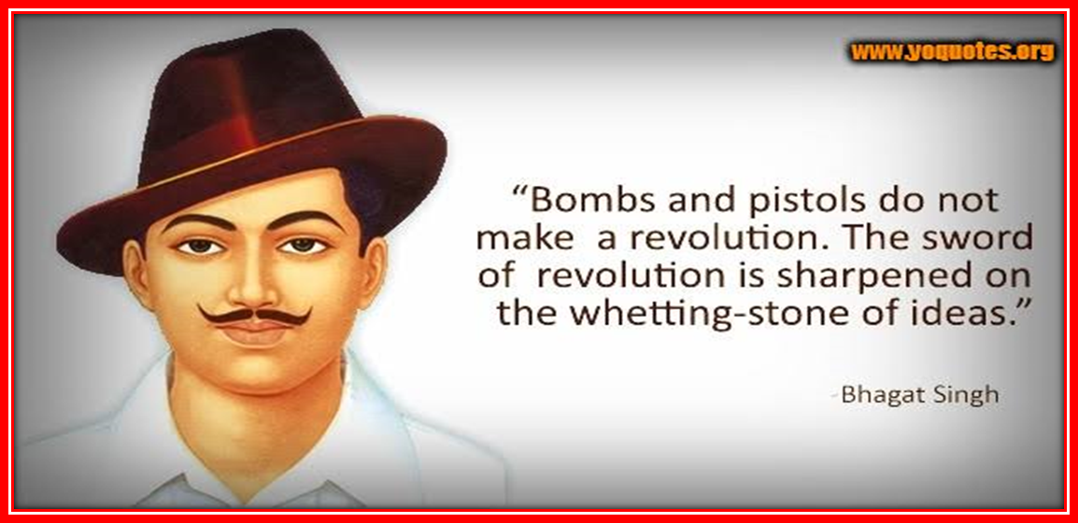
WEL COME TO
SOCIAL STUDIES
QUIZ
TEAM – GREEN

Slide 17
Q.1. The word livres stands for ……
A) Tax levied by the Church
B) Tax to be paid directly to the State
C) Unit of currency in France
D) None of the above
NEXT

Slide 18
Q.2. Which group of people did not join the Jacobin club ?
A) Men with property
B) Artisans
C) Shopkeepers
D) Daily-wage workers
NEXT

Slide 19
Q.3. What was ‘Estates general’ ?
A) A political body
B) Army General
C) Head of land
D) Minister
NEXT

Slide 20
Q.4. Which of these books was written by John Locke ?
A) The Spirit of the Laws
B) Two Treatises on Govt
C) The Social Contract
D) Theory of Evolution
NEXT

Slide 21
Q.5. My friend hails from a country which does not share land boundary with India. Identify the country…
A) Bangladesh
B) Nepal
C) Bhutan
D) Tajikistan
NEXT

Slide 22
Q.6. What is the position of India in the world in respect of area ?
A) 7th position
B) 8th position
C) 9th position
D) 5th position
NEXT

Slide 23
Q.7. The head of the government in Nepal is,
A) Prime Minister
B) President
C) King
D) Vice President
NEXT

Slide 24
Q. 8. What is Constitutional Law ?
A) Law to make Constitution
B) Law to set up Constitution Assembly
C) Law that rule country
D) Provisions given in the Constitution
NEXT

Slide 25
Q.9. The ‘Green Revolution’ introduced the formers to…..
A) Cultivation of green vegetables
B) Cultivation of forests
C) Cultivation of sugarcane
D) Cultivation of wheat and rice
NEXT

Slide 26
Q.10. Working capital stands for,
A) Tools, machines and buildings
B) Raw materials and money in hand
C) Total share capital
D) Fixed deposits in financial institutions
NEXT

Slide 27
THANK YOU

Slide 28
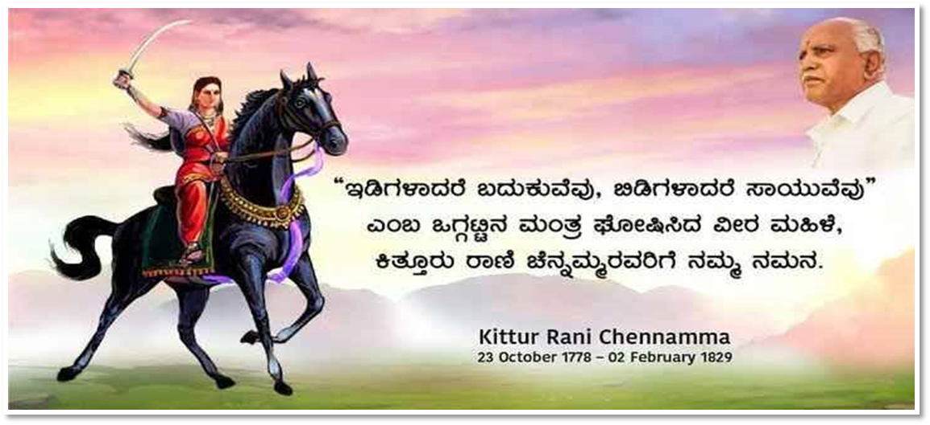
WEL COME TO
SOCIAL STUDIES
QUIZ
TEAM – RED

Slide 29

Q.1. Which one of the following is not an effect of the modern farming ?
A) Soil degradation
B ) Water pollution
C) Deforestation
D) Decrease in groundwater
NEXT

Slide 30
Q.2. Multiple cropping means, growing……
A) Only two crops
B) Only three crops
C) More than one crop
D) Upto four crops
NEXT

Slide 31
Q.3. How many members are elected to the National people’s Congress from all over China ?
A) 3500
B) 3050
C) 3000
D) 4000
NEXT

Slide 32
Q.4. Some of the drawbacks of democracy is,
A) Instability and delays
B) Corruption and hypocrisy
C) Politicians fighting among themselves
D) All the above
NEXT

Slide 33
Q.5. Which line divides India into approximately two equal parts ?
A) Tropic of Cancer
B) The Equator
C) Tropic of Capricorn
D) None of these
NEXT

Slide 34
Q.6. The latitudinal extent of India lies between,
A) 7° 5’ N and 26° 5’ N
B) 8° 4’ N and 37° 6’ N
C) 12° 5’ N and 27° 5’ N
D) 12° 5’ N and 37° 6’ N
NEXT

Slide 35
Q.7. The Which of the following is the oldest route of contact between India and other countries of the world ?
A) Land route
B) Ocean route
C) Maritime contact
D) Air route
NEXT

Slide 36
Q.8. Which of the following were the two leaders of National Assembly of France ?
A) Mirabeau and Voltaire
B) Mirabeau and Rousseau
C) Mirabeau and Abbe Sieyes
D) Mirabeau and Montesquieu
NEXT

Slide 37
Q.9. The Third Estate comprised ….
A) Servants and peasants
B)Landless labourers and artisans
C) businessmen, merchants, lawyers
D) All the above
NEXT

Slide 38
Q.10. The French Revolution started in,
A) 1879
B) 1789
C) 1779
D) 1709
NEXT

Slide 39
THANK YOU

Slide 40
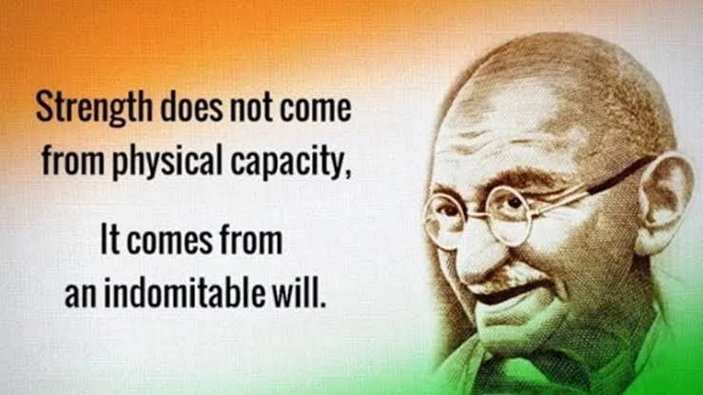
WEL COME TO
SOCIAL STUDIES
QUIZ
TEAM – YELLOW

Slide 41
Q.1. The book ‘The Spirit of Laws’ written by,
A) Rousseau
B ) Montesquieu
C) Voltaire
D) John Locke
NEXT

Slide 42
Q.2. According to the new constitution of 1791, the National Assembly was to be,
A) Elected indirectly
B) Appoint by the King
C) A hereditary body
D) Elected directly
NEXT

Slide 43
Q.3. Which period is referred to as the ‘Reign of Terror’ ?
A) From 1793 to 1794
B) From 1798 to 1799
C) From 1789 to 1790
D) From 1793 to 1795
NEXT

Slide 44
Q.4. Name the group of Islands lying in the Arabian Sea…
A) Lakshadweep
B) Bay of Bengal
C) Andaman – Nicobar
D) None of the above
NEXT

Slide 45
Q.5. India has a land boundary of about …..
A) 15,250 km
B) 15,860 km
C) 15,680 km
D) 15,200 km
NEXT

Slide 46
Q.6. Which meridian is fixed as a Standard Meridian of India ?
A) 82 ½° E
B) 72 ½° E
C) 84 ½° E
D) 23 ½° E
NEXT

Slide 47
Q.7. Democracy improves the :
A) Dignity of the people
B ) The quality of decision-making
C) Economy of the country
D) All the above
NEXT

Slide 48
Q.8. Which organ of the government is required to protect the rights of the citizens ?
A) Legislature
B) Executive
C) Police
D) Independent Judiciary
NEXT

Slide 49
Q.9. During the winter season, farmers in Palampur grow……
A) Jowar
B) Rice
C) Bajra
D) Wheat
NEXT

Slide 50
Q.10. The concept of white revolution is associated with,
A) Cotton
B) Food crops
C) Sugarcane
D) Milk
NEXT

Slide 51

Thank You

